Slide 1
Epidemiology of HIV/AIDS and STDs
Dr Prosper Okonkwo

Slide 2
Outline
Introduction
Epidemiology
Natural History
Transmission
Predisposing Factors (Drivers of Infection)
Impact of HIV Infection
Management of HIV Infection
Prevention of HIV and STDs

Slide 3
Introduction
Not clear how many people were infected with HIV or developed AIDS before the early 1980s.
In 1981, cases of very rare lung diseases were found in five young previously healthy gay men in Los Angeles.
At the same time, cases of unusually severe among a group of men in New York were reported.
Later same year, the first cases of these lung diseases were reported among people who inject drugs
By the end of that year, about 270 cases of severe immune deficiency among gay men were reported, leading to more than 120 deaths.
Studies suggested that sexual, blood transfusion and injecting drugs as routes of transmission.

Slide 4
Introduction
CDC first used the term AIDS to describe the disease in 1982.
Later AIDS was reported amongst female partners of positive men, suggesting it could be passed on through heterosexual routes.
The virus that caused AIDS was discovered in France in 1983, first called Lymphadenopathy-Associated Virus (LAV) and later in 1986, Human Immunodeficiency Virus (HIV)
Mother to Child transmission was also recognized as a route for infecting unborn children
Casual contacts, food, air and water were excluded as usual routes of transmission
Over the years, increasingly more sensitive and effective reagents and drugs have been developed, making diagnosis easier, and AIDS now regarded as a chronic disease

Slide 5
Introduction
The Human Immunodeficiency Virus (HIV) {INFECTION} is the cause of the spectrum of disease known as AIDS. {DISEASE}
HIV is of the retrovirus class of viruses that primarily infects components of the human immune system such as CD4⁺ T cells, macrophages and dendritic cells. It directly and indirectly destroys CD4⁺ T cells
Two types of HIV have been characterized: HIV-1 and HIV-2.
HIV-1 is the predominant and first described virus.
In contrast, HIV 2 is mostly found in West Africa and accounts for less than 1% of infections worldwide

Slide 6
Brief History-Nigeria
The first two cases in Nigeria were diagnosed in Lagos in 1985
One of the first two cases was a young female teenager aged 13 years from one of the West African Countries
The Nigerian public received the news of the presence of AIDS in the country with doubt and disbelief.
AIDS was then perceived as the disease of a distant land which had no place in Nigerian society as the first case was from a foreigner.

Slide 7
Important Definitions
Window period. Time between when a person is infected with HIV and when antibody test is positive
Antibodies usually develop in infected people between 4 to 6 weeks but may take as long as 3 months to be detectable. Retest if high index of suspicion
Asymptomatic HIV infection. Occurs in a person who is HIV infected but looks and feels healthy
Symptomatic HIV infection. Occurs in a person who has developed physical signs of HIV
Opportunistic infections. Illnesses caused by a germ that might not otherwise cause illness in a healthy person, but will in persons with weakened immune system

Slide 8
Natural History of HIV
Natural history relates to the possible course a disease would take if no interventions like treatment are instituted
Virus can be transmitted during each stage
Seroconversion. Infection with HIV and antibody development
Asymptomatic. No signs yet of HIV. Immune system controls virus production
Symptomatic. Physical signs of HIV infection with some immune suppression
AIDS. Opportunistic infections and end stage disease.

Slide 9
Natural History of HIV
Immune Suppression
The Virus attacks white blood cells (CD4 cells) that are protective
Over time, the body looses its immune defence system
Opportunistic Infections then occur

Slide 10
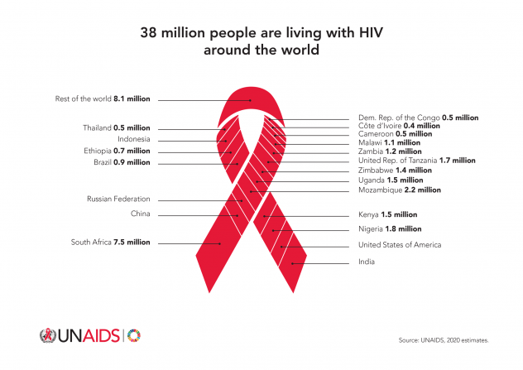
Global Picture: 38 million living with HIV-2020

Slide 11
Current Epidemiology (2020)
38 million people globally were living with HIV.
1.7 million people became newly infected with HIV.
81% of all people living with HIV knew their HIV.
26 million people were accessing antiretroviral therapy
67% of all people living with HIV were accessing HIV treatment
Among people accessing treatment, three out of five (60%) were virally suppressed.
76 million cumulative infected with HIV since the start of the epidemic

Slide 12
Epidemiology-Nigeria
HIV Estimates 2019 (Source- UNAIDS)
 | Indicators | Numbers or %
1. | Number of Nigerians living with HIV | 1,800,000
2. | Number of annual new infections | 100,000
3. | Number of Anti Retroviral Drugs (ART) | 1,141,064*
4. | Percentage Knowing their status | 73%
5. | Percentage of HIV Patients on ART | 65%
6. | Percentage of HIV patients who are virally suppressed | 80%
Notes:
What is NAIIS and what makes it different from other surveys?

Slide 13
Nigeria HIV Prevalence

Slide 14
HIV Prevalence in Nigeria
HIV prevalence is dropping in the general population at 1.4%, but still high among key populations
MSM -22.9%
Sex Workers
Brothel based - 19.4%
Non brothel based - 8.6%
PWID-3.4%

Slide 15
HIV Prevalence by States (NAIIS 2018)
Notes:
Discuss the changes relative to the last survey

Slide 16
HIV Prevalence by Geopolitical Zones (NAIIS 2018)
Notes:
Discuss any glaring features on this graph.
Geopolitical zones differences
Sex differences

Slide 17
HIV Prevalence by Age and Sex (NAIIS 2018)
Notes:
What can you see?
The need for tailored interventions.

Slide 18
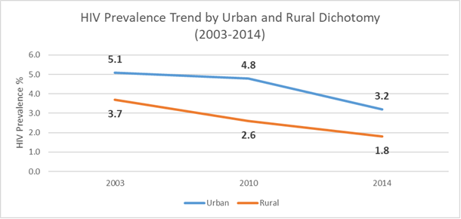
HIV Prevalence Trend- Urban vs. Rural

Slide 19
HIV Transmission
Sexual
Vaginal (99% of sexual transmission)
Anal
Oral sex
Parenterally
transfusion of infected blood/blood products
Donated organs
Unsterilized needles

Slide 20
HIV Transmission
Perinatally- Mother to Child Transmission (MTCT) occurs:
During pregnancy
Labor and delivery
Breastfeeding
Occupational Transmission
Health care workers
Laboratory staff

Slide 21
Perinatal Transmission**
Perinatal transmission accounts for about 90% of pediatric infections
20% in utero
60-65% at delivery
12-15% via breast milk
25-40% transmission in the absence of intervention in SSA.
Notes:
Breast feeding
Cost
Ignorance
Stigma and family pressure
Clean water argument
Anti Retroviral drugs

Slide 22
Drivers of HIV Epidemic in Nigeria
Low personal risk perception.
Multiple concurrent sexual partnership
Transactional and intergenerational sex
Sexual transmission among key populations (MSM, Brothel based FSW and Non-brothel based FSW)
Sexually transmitted diseases (genital ulcers and Non-ulcerative STIs)

Slide 23
Drivers of HIV Epidemic
Poor health care delivery system.
Stigma and discrimination
Socio-economic factors
Cultural factors:
Early marriage
Widowhood rite and widow inheritance
Polygamy, polyandry and concubinage

Slide 24
Management
Diagnosis
Clinical (Staging no longer very useful-Test and Treat)
Laboratory
Prevention
Care
Laboratory monitoring
Opportunistic Infections
Treatment (Pre/Post exposure prophylaxis, ART Therapy, TasP)

Slide 25
Prevention
Combination prevention. Simultaneous employment of different approaches and intervention types for prevention of HIV infection. Minimum Prevention Package intervention (MPPI) combines a set of approaches
Biomedical approach (Clinic and community based approaches to reduce exposure and risk of transmission and infection. Examples)
Behavioural approach (Behaviour Change Communication). Gap between knowledge and behaviour is a challenge
Structural approach. Targets social, legal, political and economic factors that increase vulnerability to HIV
Best Results achieved when all the methods are combined in some measure

Slide 26
Global Impact of HIV
Negative economic Impact
Impact on health systems
Reversal of gains of childhood survival
Increasing Orphan Population
Decreasing life Expectancy

Slide 27
Sexually Transmitted Infections/Diseases

Slide 28
Definitions and Overview
A sexually transmitted infection (STI) is an infection that can be contacted by having sex.
Sexually transmitted diseases (STDs) are a group of infectious or communicable diseases in which the primary mode of transmission is through sexual contact.
As highlighted earlier, the emphasis now is more on infections, since infected people can transmit the infective agents, even before overt signs and symptoms of disease manifest.
Although all STDs are preceded by STIs, not all STIs result in the development of STDs.
For instance, about 90% of women who are infected with human papillomavirus (HPV) clear their infections within two years. Only a few others go on to develop cancer of the cervix

Slide 29
Classification
Etiologically ( by type of causative agent)
By type of lesions
By route of Transmission*

Slide 30
Classification by Causative Organisms
Bacterial
Gonorrhea
Chlamydia
Syphilis
Viral
HIV/AIDS
Genital Herpes
Human Papilloma Virus
Viral Hepatitis
Zika
Parasitic
Trichomoniasis
Fungal
Candidiasis

Slide 31
Classification
By type of Lesions
Ulcers
Warts
Cancers
By routes of transmission
Vaginal
Anal
Oral
Blood
Skin contact

Slide 32
Epidemiology
Global
The majority of STIs have no symptoms or only mild symptoms that may not be recognized as STIs.
STIs such as Herpes Simplex Virus syphilis can increase the risk of HIV acquisition.
In some cases, STIs can have serious reproductive health consequences beyond the immediate impact of the infection itself (e.g., infertility or mother-to-child transmission)
Drug resistance, especially for gonorrhea, is a major threat to reducing the impact of STIs worldwide.

Slide 33
Epidemiology
Many STIs—including chlamydia, gonorrhea, primarily hepatitis B, HIV, and syphilis—can also be transmitted from mother to child during pregnancy and childbirth.
Common symptoms of STIs include vaginal discharge, urethral discharge or burning in men, genital ulcers, and abdominal pain.

Slide 34
Common STIs
There are many STIs, but only a few of the more common ones are listed below.
Chlamydia
Gonorrhea
Syphilis
Genital Herpes
Trichonomiasis
Human papilloma Virus
Viral Hepatitis
Bacterial vaginosis
HIV/AIDS
Zika*

Slide 35
General Principles of Management
Prevention
Tailored Counseling and behavioral approaches
Barrier methods
High index of suspicion/early diagnosis. Useful, particularly in asymptomatic cases
Prompt Treatment – symptomatic and definitive
Responsible use of antibiotics
Vaccines. Hep B and HPV and few others still in the pipeline
Vaginal microbicide

Slide 36
Summary Issues
Many infections are asymptomatic, but very infective.
Common Symptoms
While most are sexually contacted, some can be acquired by other means. E.g. blood transfusion.
Antibiotics useful, but should not be abused.
Reproductive Health outcomes negatively affected by STIs/STDs
STIs are strong determinants to HIV infections

